Slide 1


Exposure Java 2013
APCS Edition
Chapter 10 Slides
Java Static 1D & 2D Arrays
PowerPoint Presentation
created by:
Mr. John L. M. Schram
and Mr. Leon Schram
Authors of Exposure Java

Slide 2
Section 10.1
Introduction to
Data Structures

Slide 3

First Data Structure Definition
A data structure is a data type whose components are smaller data structures and/or simple data types.

Slide 4


Data Structure Starting Point
Any data type that can store more than one value is a data structure.

Slide 5







First Array Definition
An array is a data structure with one, or more, elements of the same type.
A 1-dimensional array is frequently called a vector.
A 2-dimensional array is frequently called a matrix.
The array is the first historical data structure which was introduced in the language FORTRAN.

Slide 6
Record Definition
A record is a data structure with one, or more, elements, called fields, of the same or different data types.
The language FORTRAN did NOT
have records which is why it
was NOT good for business.
COBOL (Common Business
Oriented Language) introduced
the record data structure.

Slide 7
A Note About Classes
A class is a record
that can also store methods.

Slide 8
File Definition
A file is an internal data structure - with an unspecified number of elements of the same type - assigned to an external file name.
The file data structure
allows transfer of data
between internal and
external storage.

Slide 9
Stack Definition
A stack is a data structure with elements of the same type.
Data elements of the stack data structure can only be accessed (stored or retrieved) at one end of the stack in a LIFO (Last In, First Out) manner.

Slide 10
Improved Data Structure Definition
A data structure is a data type whose components are smaller data structures and/or simple data types.
The storing and retrieval of the data elements is performed by accessing methods that characterize the data structure.

Slide 11
Section 10.2
Array
Definition

Slide 12
First Array Definition Again
An array is a data structure with one, or more, elements of the same type.
How exactly
is this different
from a stack?

Slide 13
Improved Array Definition
An array is a data structure with a fixed number of elements of the same type.
Every element of the array can be accessed directly.
Both a stack and an array
store elements of the same type,
but each accesses the data differently,
which makes them different data structures.

Slide 14
Array Example
[16] Ingrid | [17] Darlene | [18] Gene | [19] Sean | [20] Stephanie
[11] Holly | [12] Blake | [13] Michelle | [14] Remy | [15] Haley
[06] Diana | [07] Jessica | [08] David | [09] Anthony | [10] Alec
[01] Isolde | [02] John | [03] Greg | [04] Maria | [05] Heidi

Slide 15
Section 10.3
1D Array
Declarations
and Access

Slide 16
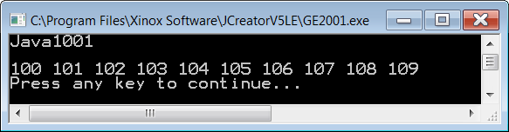
// Java1001.java This program declares 10 different int variables.
// Each variable is assigned a value and each variable value is displayed.
// This approach is very inefficient for a large number of variables.
public class Java1001
{
public static void main(String args[])
{
System.out.println("Java1001\n");
int number0 = 100; int number1 = 101;
int number2 = 102; int number3 = 103;
int number4 = 104; int number5 = 105;
int number6 = 106; int number7 = 107;
int number8 = 108; int number9 = 109;
System.out.print(number0 + " ");
System.out.print(number1 + " ");
System.out.print(number2 + " ");
System.out.print(number3 + " ");
System.out.print(number4 + " ");
System.out.print(number5 + " ");
System.out.print(number6 + " ");
System.out.print(number7 + " ");
System.out.print(number8 + " ");
System.out.print(number9 + " ");
System.out.println();
}
}

Slide 17
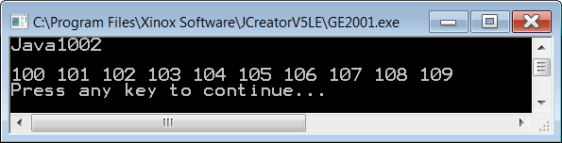
// Java1002.java This program declares an array of 10 <int> elements.
// Each array element value is individually assigned and displayed.
// There does not appear any real benefit from the from program example.
public class Java1002
{
public static void main(String args[])
{
System.out.println("Java1002\n");
int list[]; // declares the array object identifier
list = new int[10]; // allocates memory for 10 array elements
list[0] = 100; list[1] = 101;
list[2] = 102; list[3] = 103;
list[4] = 104; list[5] = 105;
list[6] = 106; list[7] = 107;
list[8] = 108; list[9] = 109;
System.out.print(list[0] + " ");
System.out.print(list[1] + " ");
System.out.print(list[2] + " ");
System.out.print(list[3] + " ");
System.out.print(list[4] + " ");
System.out.print(list[5] + " ");
System.out.print(list[6] + " ");
System.out.print(list[7] + " ");
System.out.print(list[8] + " ");
System.out.print(list[9] + " ");
System.out.println();
}
}
Index | Value
0 | 100
1 | 101
2 | 102
3 | 103
4 | 104
5 | 105
6 | 106
7 | 107
8 | 108
9 | 109

Slide 18
Array Index Note
Java arrays indicate individual elements with an index inside two brackets, following the array identifier, like list[3]
The array index is always an integer and starts at 0.
In an array of N elements, the largest index is N-1.

Slide 19

// Java1003.java
// The previous program with separate statements for each array member
// assignment and display is now replaced with two loops. The loop counter,
// index, is used to specify each array element in an efficient manner.
public class Java1003
{
public static void main(String args[])
{
System.out.println("Java1003\n");
int list[];
list = new int[10];
for (int index = 0; index <=9; index++)
list[index] = index + 100;
for (int index = 0; index <=9; index++)
System.out.print(list[index] + " ");
System.out.println();
}
}
Index | Value
0 | 100
1 | 101
2 | 102
3 | 103
4 | 104
5 | 105
6 | 106
7 | 107
8 | 108
9 | 109

Slide 20
Defining Static Arrays
int list[]; // declares the array list identifier
list = new int[10]; // allocates memory for 10 integers
char names[]; // declares the names array identifier
names = new char[25]; // allocates memory for 25 characters
double grades[]; // declares the grades array identifier
grades = new double[50]; // allocates memory for 50 doubles
In some old programming languages
that do not have a String data type,
an Array of characters is used instead.

Slide 21
Defining Static Arrays Preferred Method
int list[ ] = new int[10];
char names[ ] = new char[25];
double grades[ ] = new double[50];

Slide 22
This is similar to what you learned in Chapters 3 & 6.
Chapter | This will work: | This is preferred:
3 | int x; x = 5; | int x = 5;
6 | Bank tom; tom = new Bank(); | Bank tom = new Bank();
10 | int list[ ]; list = new int [10]; | int list[ ] = new int[10];

Slide 23
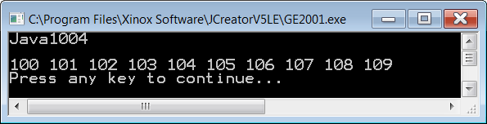
// Java1004.java
// This program is the same list array and the same list values
// as the previous program. This time note that the array declaration
// is accomplished with a single statement.
public class Java1004
{
public static void main(String args[])
{
System.out.println("Java1004\n");
int list[] = new int[10];
for (int index = 0; index <=9; index++)
list[index] = index + 100;
for (int index = 0; index <=9; index++)
System.out.print(list[index] + " ");
}
}
Index | Value
0 | 100
1 | 101
2 | 102
3 | 103
4 | 104
5 | 105
6 | 106
7 | 107
8 | 108
9 | 109

Slide 24
// Java1005.java
// This program demonstrates how to initialize array elements.
// The <new> operator is not necessary in this case.
public class Java1005
{
public static void main(String args[])
{
System.out.println("Java1005\n");
int list[] = {100,101,102,103,104,105,106,107};
for (int k = 0; k <= 7; k++)
System.out.println("list[" + k + "] = " + list[k]);
System.out.println();
}
}
This is called an initializer list.
Note that the size of the array does not need to be specified.

Slide 25
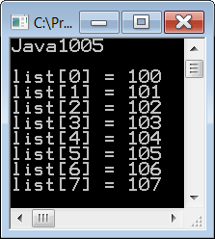
// Java1005.java
// This program demonstrates how to initialize array elements.
// The <new> operator is not necessary in this case.
public class Java1005
{
public static void main(String args[])
{
System.out.println("Java1005\n");
int list[] = {100,101,102,103,104,105,106,107};
for (int k = 0; k <= 7; k++)
System.out.println("list[" + k + "] = " + list[k]);
System.out.println();
}
}
0 | 1 | 2 | 3 | 4 | 5 | 6 | 7
100 | 101 | 102 | 103 | 104 | 105 | 106 | 107

Slide 26
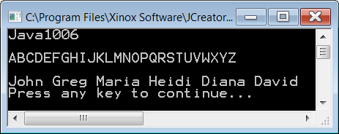
// Java1006.java
// This program demonstrates a character array and a string array.
// Both arrays use an initializer list.
public class Java1006
{
public static void main(String args[])
{
System.out.println("Java1006\n");
char list1[] = {'A','B','C','D','E','F','G','H','I','J','K','L','M',
'N','O','P','Q','R','S','T','U','V','W','X','Y','Z'};
for (int k = 0; k < 26; k++)
System.out.print(list1[k]);
System.out.println("\n");
String list2[] = {"John","Greg","Maria","Heidi","Diana","David"};
for (int k = 0; k < 6; k++)
System.out.println(list2[k]);
System.out.println();
}
}
0 | 1 | 2 | 3 | 4 | 5 | 6 | 7 | 8 | 9 | 10 | 11 | 12 | 13 | 14 | 15 | 16 | 17 | 18 | 19 | 20 | 21 | 22 | 23 | 24 | 25
A | B | C | D | E | F | G | H | I | J | K | L | M | N | O | P | Q | R | S | T | U | V | W | X | Y | Z
list2 | 0 | 1 | 2 | 3 | 4 | 5
 | John | Greg | Maria | Heidi | Diana | David

Slide 27
// Java1106.java
// This program demonstrates a character array and a string array.
// Both arrays use an initializer list.
public class Java1106
{
public static void main(String args[])
{
System.out.println("Java1106\n");
char list1[ ] = {'A','B','C','D','E','F','G','H','I','J','K','L','M',
'N','O','P','Q','R','S','T','U','V','W','X','Y','Z'};
for (int k = 0; k < 26; k++)
System.out.print(list1[k]);
System.out.println("\n");
String list2[ ] = {"John","Greg","Maria","Heidi","Diana","David"};
for (int k = 0; k < 6; k++)
System.out.println(list2[k]);
System.out.println();
}
}
Try This!
Add one or more names to this list.
Will they show up in the output? Why?

Slide 28
// Java1106.java
// This program demonstrates a character array and a string array.
// Both arrays use an initializer list.
public class Java1106
{
public static void main(String args[])
{
System.out.println("Java1106\n");
char list1[ ] = {'A','B','C','D','E','F','G','H','I','J','K','L','M',
'N','O','P','Q','R','S','T','U','V','W','X','Y','Z'};
for (int k = 0; k < 26; k++)
System.out.print(list1[k]);
System.out.println("\n");
String list2[ ] = {"John","Greg","Maria","Heidi","Diana","David"};
for (int k = 0; k < 6; k++)
System.out.println(list2[k]);
System.out.println();
}
}
Now Try This!
Remove several names from this list.
Does the program still work? Why?

Slide 29
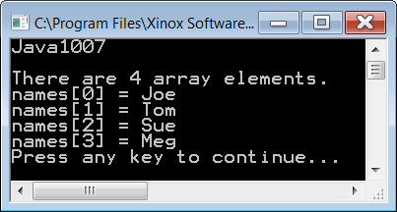
// Java1007.java
// This program introduces the length field to determine the
// number of elements in the array. Remove the comments from line 18
// to observe what happens when the length field is altered.
public class Java1007
{
public static void main(String args[])
{
System.out.println("Java1007\n");
String names[ ] = {"Joe","Tom","Sue","Meg"};
int n = names.length; // data field access; not a method call
System.out.println("There are " + n + " array elements.");
for(int k = 0; k < n ; k++)
System.out.println("names[" + k + "] = " + names[k]);
// names.length = 10;
}
}
0 | 1 | 2 | 3
Joe | Tom | Sue | Meg

Slide 30
// Java1007.java
// This program introduces the length field to determine the
// number of elements in the array. Remove the comments from line 16
// to observe what happens when the length field is altered.
public class Java1107
{
public static void main(String args[])
{
System.out.println("Java1007\n");
String names[ ] = { "Joe","Tom","Sue","Meg"};
int n = names.length; // data field access; not a method call
System.out.println("There are " + n + " array elements.");
for(int k = 0; k < n ; k++)
System.out.println("names[" + k + "] = " + names[k]);
// names.length = 10;
}
}
Try This!
Add one or more names to this list.
Will they show up in the output? Why?
Why is this different from program Java1006?

Slide 31
// Java1007.java
// This program introduces the length field to determine the
// number of elements in the array. Remove the comments from line 16
// to observe what happens when the length field is altered.
public class Java1107
{
public static void main(String args[])
{
System.out.println("Java1007\n");
String names[ ] = { "Joe","Tom","Sue","Meg"};
int n = names.length; // data field access; not a method call
System.out.println("There are " + n + " array elements.");
for(int k = 0; k < n ; k++)
System.out.println("names[" + k + "] = " + names[k]);
// names.length = 10;
}
}
Now Try This!
Remove several names from this list.
Does the program still work? Why?
Why is this different from program Java1006?

Slide 32
// Java1007.java
// This program introduces the length field to determine the
// number of elements in the array. Remove the comments from line 16
// to observe what happens when the length field is altered.
public class Java1107
{
public static void main(String args[])
{
System.out.println("Java1007\n");
String names[ ] = { "Joe","Tom","Sue","Meg"};
int n = names.length; // data field access; not a method call
System.out.println("There are " + n + " array elements.");
for(int k = 0; k < n ; k++)
System.out.println("names[" + k + "] = " + names[k]);
// names.length = 10;
}
}
Try This Also!
Remove the comment symbol from the last program statement in this program.
Will the program still compile?

Slide 33
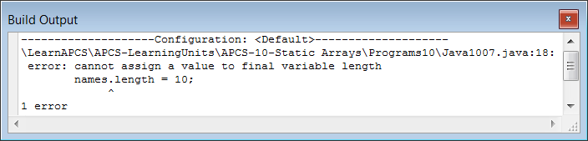
// Java1007.java
// This program introduces the length field to determine the
// number of elements in the array. Remove the comments from line 16
// to observe what happens when the length field is altered.
public class Java1007
{
public static void main(String args[])
{
System.out.println("Java1107\n");
String names[] = {"Joe","Tom","Sue","Meg"};
int n = names.length; // data field access; not a method call
System.out.println("There are " + n + " array elements.");
for(int k = 0; k < n ; k++)
System.out.println("names[" + k + "] = " + names[k]);
names.length = 10;
}
}
NO!
The length field is a
final or constant attribute
just like the PI in Math.PI

Slide 34
Static Arrays vs. Dynamic Arrays
The size or length of a static array cannot
be changed.
This is why it is called a static array.
The size of a dynamic array can be changed.
You will learn about dynamic arrays in the next chapter.

Slide 35
Section 10.4
Random
Arrays

Slide 36
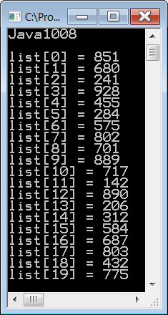
// Java1008.java
// This program fills an <int> array with a random set of numbers.
import java.util.Random; // necessary to use the <Random> class
public class Java1008
{
public static void main(String args[])
{
System.out.println("Java1008\n");
int list[] = new int[20];
Random random = new Random(12345);
for (int k = 0; k < 20; k++)
list[k] = random.nextInt(900) + 100;
for (int k = 0; k < 20; k++)
System.out.println("list[" + k + "] = " + list[k]);
System.out.println();
}
}
0 | 1 | 2 | 3 | 4 | 5 | 6 | 7 | 8 | 9 | 10 | 11 | 12 | 13 | 14 | 15 | 16 | 17 | 18 | 19
851 | 680 | 241 | 928 | 455 | 284 | 575 | 802 | 701 | 889 | 717 | 142 | 890 | 206 | 312 | 584 | 687 | 803 | 432 | 775

Slide 37
// Java1009.java
// This program will display 15 random sentences.
// With 7 different ranks, 7 different people, 7 different actions and 7 different locations,
// there are more than 2400 different sentences possible.
System.out.println("Java1009\n");
Random random = new Random();
String rank[ ] = {"Private","Corporal","Sargent","Lieutenant","Captain","Major","General"};
String person[ ] = {"Smith", "Gonzales", "Brown", "Jackson", "Powers", "Jones", "Nguyen"};
String action[ ] = {"drive the tank", "drive the jeep", "take the troops", "bring all supplies",
"escort the visitor", "prepare to relocate", "bring the Admiral"};
String location[ ] = {"over the next hill", "to the top of the mountain", "outside the barracks",
"30 miles into the dessert", "to the middle of the forest",
"to my present location", "to anywhere but here"};
for (int j = 1; j <= 15; j++)
{
int randomRank = random.nextInt(rank.length);
int randomPerson = random.nextInt(person.length);
int randomAction = random.nextInt(action.length);
int randomLocation = random.nextInt(location.length);
String sentence = rank[randomRank] + " " + person[randomPerson] + " " +
action[randomAction] + " " + location[randomLocation] + ".";
System.out.println("\n" + sentence);
}

Slide 38
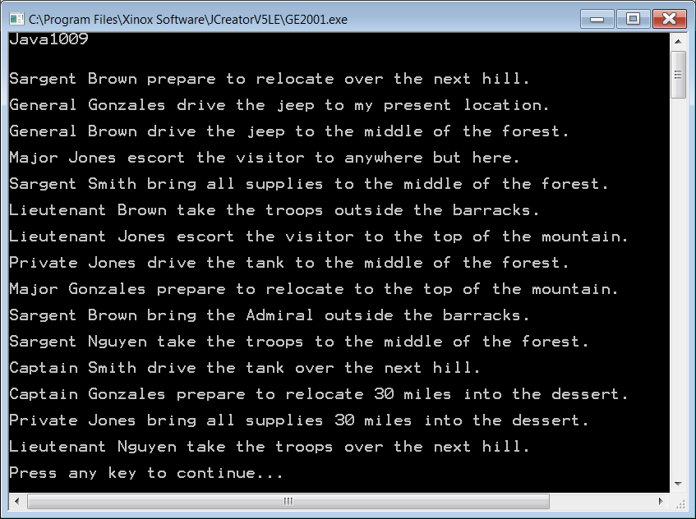

Slide 39
Section 10.5
Accessing Array Elements with
the <for..each> Loop Structure

Slide 40
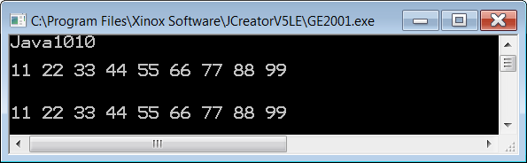
// Java1010.java
// This program introduces the Java Version 5.0 enhanced <for..each> loop
// with an <int> array.
public class Java1010
{
public static void main(String args[])
{
System.out.println("Java1010\n");
int list[] = {11,22,33,44,55,66,77,88,99};
for (int k = 0; k < 9; k++) // Old <for> loop syntax
System.out.print(list[k] + " ");
System.out.println("\n\n");
for (int item: list) // New <for> loop syntax
System.out.print(item + " ");
System.out.println("\n\n");
}
}

Slide 41
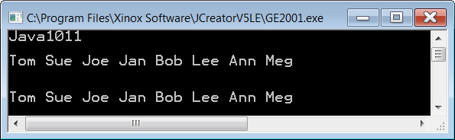
// Java1011.java
// This program uses the Java Version 5.0 <for..each> loop with a <String> array.
public class Java1011
{
public static void main(String args[])
{
System.out.println("Java1011\n");
String names[] = {"Tom","Sue","Joe","Jan","Bob","Lee","Ann","Meg"};
for (int k = 0; k < 8; k++) // Old <for> loop syntax
System.out.print(names[k] + " ");
System.out.println("\n\n");
for (String name: names) // New <for> loop syntax
System.out.print(name + " ");
System.out.println("\n\n");
}
}

Slide 42

// Java1012.java
// This program demonstrates a very generalized <for..each> loop usage
// with the <Object> class.
public class Java1012
{
public static void main(String args[])
{
System.out.println("Java1012\n");
String names[] = {"Tom","Sue","Joe","Jan","Bob","Lee","Ann","Meg"};
for (int k = 0; k < 8; k++)
System.out.print(names[k] + " ");
System.out.println("\n\n");
for (Object obj: names)
System.out.print(obj + " ");
System.out.println("\n\n");
}
}

Slide 43
Enhancing the for Loop
The enhanced for loop is called the for .. each loop.
This loop structure is available in Java 5.0
The new loop structure does not replace the older for loop, because it is not possible to access specific array elements.
int numbers[ ] = {1,2,3,4,5,6,7,8,9};
for (int number: numbers)
System.out.print(number + " ");

Slide 44
Section 10.6
Introduction to
Static 2D Arrays

Slide 45
2-D Array Example
[04][01] Ingrid | [04][02] Darlene | [04][03] Gene | [04][04] Sean | [04][05] Stephanie
[03][01] Holly | [03][02] Blake | [03][03] Michelle | [03][04] Remy | [03][05] Haley
[02][01] Diana | [02][02] Jessica | [02][03] David | [02][04] Anthony | [02][05] Alec
[01][01] Isolde | [01][02] John | [01][03] Greg | [01][04] Maria | [01][05] Heidi

Slide 46
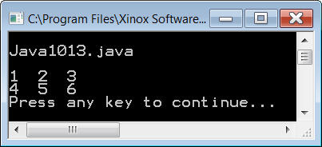
// Java1013.java
// This program introduces 2D Java static arrays. For 2D arrays two sets of index operators are
// needed. The first set of index brackets stores the rows value. The second set of index operators
// stores the cols value. The <twoD> array in this program is a 2 X 3 array.
public class Java1013
{
public static void main(String args[])
{
System.out.println("\nJava1013.java\n");
int twoD[][]; // declaration of two-dimensional integer array
twoD = new int[2][3]; // new 2D array is constructed with 2 rows and 3 columns
twoD[0][0] = 1;
twoD[0][1] = 2;
twoD[0][2] = 3;
twoD[1][0] = 4;
twoD[1][1] = 5;
twoD[1][2] = 6;
System.out.print(twoD[0][0] + " ");
System.out.print(twoD[0][1] + " ");
System.out.print(twoD[0][2] + " "); System.out.println();
System.out.print(twoD[1][0] + " ");
System.out.print(twoD[1][1] + " ");
System.out.print(twoD[1][2] + " "); System.out.println();
}
}

Slide 47
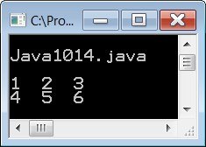
// Java1014.java
// This program stores and displays the same values in a 2 X 3 array as the previous program.
// But this time a set of nested loops is used with 2D arrays to assign and display individual values.
// Additionally, the declaration of the 2D array is done in one statement.
public class Java1014
{
public static void main(String args[])
{
System.out.println("\nJava1014.java\n");
int twoD[][] = new int[2][3]; // 2D array declaration in one statement.
int count = 1;
for (int row = 0; row < 2; row++)
{
for (int col = 0; col < 3; col++)
{
twoD[row][col] = count;
count++;
}
}
for (int row = 0; row < 2; row++)
{
for (int col = 0; col < 3; col++)
{
System.out.print(twoD[row][col] + " ");
}
System.out.println();
}
System.out.println();
}
}

Slide 48

// Java1015.java
// This program demonstrates how to use an initializer list with a 2D array to assign values.
// Commented lines 16 and 17 show a second style of using initializer lists with 2D arrays that display
// the matrix appearance.
public class Java1015
{
public static void main(String args[])
{
System.out.println("\nJava1015.java\n");
int twoD[][] = { {1,2,3}, {4,5,6} };
// int twoD[][] = { {1, 2, 3}, // Line 16
// {4, 5, 6} }; // Line 17
for (int row = 0; row < 2; row++)
{
for (int col = 0; col < 3; col++)
{
System.out.print(twoD[row][col] + " ");
}
System.out.println();
}
System.out.println();
}
}
To the computer,
these are both
identical.
This also shows that a 2D array
is an
“array of arrays”.

Slide 49
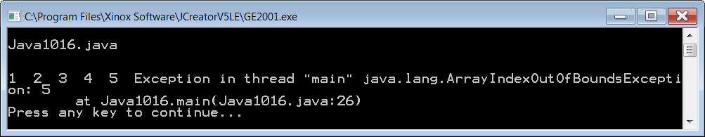
// Java1016.java
// This program demonstrates what happens when rows and columns are confused.
// A matrix of 7 rows and 5 columns is created.
// The program attempts to display 5 rows and 7 columns.
// The program will compile and execute, but then it will crash mid-display.
public class Java1016
{
public static void main(String args[])
{
System.out.println("\nJava1016.java\n");
int k = 1;
int matrix[][] = new int[7][5]; // 7 rows and 5 columns
for (int r = 0; r < 7; r++)
for (int c = 0; c < 5; c++)
{
matrix[r][c] = k;
k++;
}
System.out.println();
for (int r = 0; r < 5; r++) // should be 7
{
for (int c = 0; c < 7; c++) // should be 5
System.out.print(matrix[r][c] + " ");
System.out.println();
}
System.out.println();
}
}

Slide 50
// Java1017.java
// This program allows the user to specify the number of rows and columns.
// Note that the output will not line up nicely as it combines single, double and triple digit numbers.
import java.util.Scanner; // necessary to use the <Scanner> class
public class Java1017
{
public static void main(String args[])
{
System.out.println("\nJava1017.java\n");
Scanner input = new Scanner(System.in);
System.out.print("Enter the number of rows --> ");
int numRows = input.nextInt();
System.out.print("Enter the number of columns --> ");
int numCols = input.nextInt();
System.out.println("\n");
int k = 1;
int matrix[][] = new int[numRows][numCols];
for (int r = 0; r < numRows; r++)
for (int c = 0; c < numCols; c++)
{
matrix[r][c] = k;
k++;
}
System.out.println();
for (int r = 0; r < numRows; r++)
{
for (int c = 0; c < numCols; c++)
System.out.print(matrix[r][c] + " ");
System.out.println();
}
System.out.println();
}
}

Slide 51
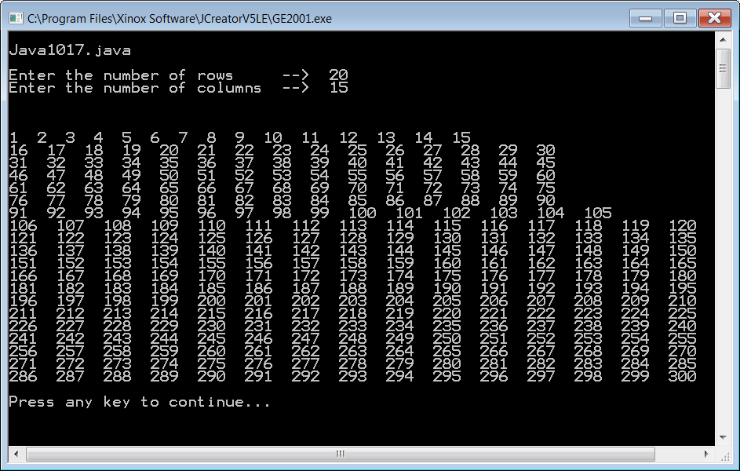

Slide 52
Section 10.7
Controlling 2D
Array Output

Slide 53
// Java1018.java
// This program demonstrates the <DecimalFormat> class.
// By using this we can make output line up properly.
import java.text.DecimalFormat; // necessary to use the <DecimalFormat> class
import java.util.Scanner; // necessary to use the <Scanner> class
public class Java1018
{
public static void main(String args[])
{
System.out.println("\nJava1018.java\n");
DecimalFormat threeDigits = new DecimalFormat("000");
Scanner input = new Scanner(System.in);
System.out.print("Enter the number of rows --> ");
int numRows = input.nextInt();
System.out.print("Enter the number of columns --> ");
int numCols = input.nextInt();
System.out.println("\n");
int k = 1;
int matrix[][] = new int[numRows][numCols]; // 7 rows and 5 columns
for (int r = 0; r < numRows; r++)
for (int c = 0; c < numCols; c++)
{
matrix[r][c] = k;
k++;
}
System.out.println();
for (int r = 0; r < numRows; r++)
{
for (int c = 0; c < numCols; c++)
System.out.print(threeDigits.format(matrix[r][c]) + " ");
System.out.println();
}
System.out.println();
}
}

Slide 54
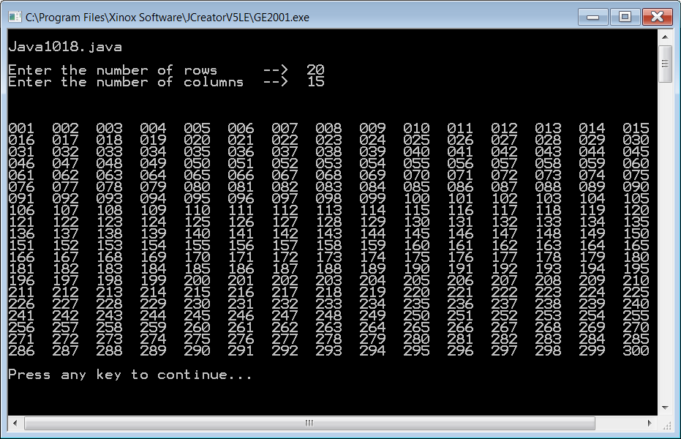

Slide 55
// Java1019.java
// This program uses the <for..each> loop to display array data.
// It also helps to illustrate that a 2D array is an array of arrays.
public class Java1019
{
public static void main(String args[])
{
System.out.println("\nJava1018.java\n");
DecimalFormat threeDigits = new DecimalFormat("000");
Scanner input = new Scanner(System.in);
System.out.print("Enter the number of rows --> ");
int numRows = input.nextInt();
System.out.print("Enter the number of columns --> ");
int numCols = input.nextInt();
System.out.println("\n");
int k = 1;
int matrix[][] = new int[numRows][numCols];
for (int r = 0; r < numRows; r++)
for (int c = 0; c < numCols; c++)
{
matrix[r][c] = k;
k++;
}
System.out.println();
for (int[] row: matrix)
{
for (int number: row)
System.out.print(threeDigits.format(number) + " ");
System.out.println();
}
System.out.println();
}
}
Same output
as the last
program

Slide 56
Close-up View of using for...each in the Outer Loop
For each array element in matrix, which is an int array called row, do the following...
for (int[ ] row: matrix)
{
for (int number: row)
System.out.print(threeDigits.format(number) + " ");
System.out.println();
}

Slide 57
Close-up View of using for...each in the Inner Loop
For each array element in row, which is an int called number, display the number.
for (int[ ] row: matrix)
{
for (int number: row)
System.out.print(threeDigits.format(number) + " ");
System.out.println();
}

Slide 58
for...each Loop Structure Limitation
The for..each loop structure is read only for any type of data structure, which include the one-dimensional array and the two-dimensional array.

Slide 59
Section 10.8
Storing Objects
in a Static Array

Slide 60
// Java1020.java
// All the previous static arrays examples showed the use of a static array to stored primitive, simple
// data type values. This program example demonstrates that a static array can store object values as
// well. In this case a static array is constructed, which stores <Student> objects.
import java.util.Scanner;
public class Java1020
{
public static void main(String args[])
{
System.out.println("\nJava1019.java\n");
Scanner stringInput = new Scanner(System.in);
Scanner intInput = new Scanner(System.in);
System.out.print("Enter the number of students ==> ");
int numStudents = intInput.nextInt();
Student students[] = new Student[numStudents];
for (int index = 0; index < numStudents; index++)
{
System.out.print("Enter student's name ==> ");
String name = stringInput.nextLine();
System.out.print("Enter student's age ==> ");
int age = intInput.nextInt();
students[index] = new Student(name,age);
}
System.out.println("\n\n");
for (int index = 0; index < numStudents; index++)
{
students[index].showData();
}
}
}
Student class
and output
on next slide

Slide 61
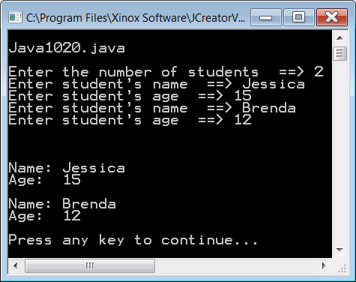
class Student
{
private String name;
private int age;
public Student(String n, int a)
{
name = n;
age = a;
}
public void showData()
{
System.out.println("Name: " + name);
System.out.println("Age: " + age);
System.out.println();
}
}

Slide 62
Section 10.9
2D Arrays
and Length

Slide 63
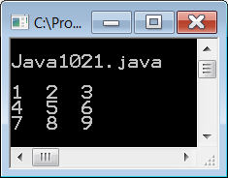
// Java1021.java
// This program creates a 3 X 3 2D array and uses a method to display the array elements.
// The length field is used for both row and column length.
public class Java1021
{
public static void main(String args[])
{
System.out.println("\nJava1021.java\n");
int[][] mat = { {1,2,3},
{4,5,6},
{7,8,9}};
displayMatrix(mat);
}
public static void displayMatrix(int[][] m)
{
for (int r = 0; r < m.length; r++)
{
for (int c = 0; c < m.length; c++)
System.out.print(m[r][c] + " ");
System.out.println();
}
System.out.println();
}
}

Slide 64
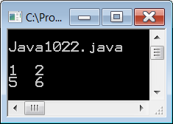
// Java1022.java
// The same <displayMatrix> method is used to display a
// 2 X 4 2D array. This time the method does not display correctly.
public class Java1022
{
public static void main(String args[])
{
System.out.println("\nJava1022.java\n");
int[][] mat = { {1,2,3,4},
{5,6,7,8}};
displayMatrix(mat);
}
public static void displayMatrix(int[][] m)
{
for (int r = 0; r < m.length; r++)
{
for (int c = 0; c < m.length; c++)
System.out.print(m[r][c] + " ");
System.out.println();
}
System.out.println();
}
}

Slide 65
2D Array Reality
A two-dimensional array is actually a one-dimensional array of one-dimensional array elements.

Slide 66
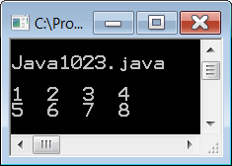
// Java1023.java
// A very slight change with the column length results in the correct array display.
public class Java1023
{
public static void main(String args[])
{
System.out.println("\nJava1023.java\n");
int[][] mat = {{1,2,3,4},
5,6,7,8}};
displayMatrix(mat);
}
public static void displayMatrix(int[][] m)
{
for (int r = 0; r < m.length; r++)
{
for (int c = 0; c < m[0].length; c++)
System.out.print(m[r][c] + " ");
System.out.println();
}
System.out.println();
}
}

Slide 67
The length Field for 2D Non-Ragged Arrays
Consider the following statement:
int matrix[][] = new int[5][4];
The value of matrix.length is 5.
This is the number of rows.
The value of matrix[0].length is 4.
This is the number of columns.
The values of matrix[1].length, matrix[2].length,
matrix[3].length and matrix[4].length are also 4.

Slide 68
Ragged Array Example
[06][01] Ingrid | [06][02] Darlene | [06][03] Gene | [06][04] Sean | [06][05] Stephanie
[05][01] Anthony | [05][02] Alec | [05][03] Haley
[04][01] Holly | [04][02] Blake | [04][03] Michelle | [04][04] Remy
[03][01] John | [03][02] Greg | [03][03] Heidi | [03][04] Maria | [03][05] David
[02][01] Diana | [02][02] Jessica
[01][01] Isolde
NOTE:
This is possible because a 2D array is essentially a 1D array of 1D arrays, and each 1D array can be a different size.

Slide 69
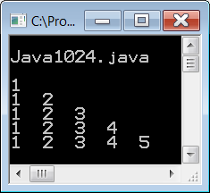
// Java1024.java
// This program demonstrates how to construct an irregular two-dimensional array
// in the shape of a triangle, using a "ragged" array.
// It also shows how to use length for different column sizes.
public class Java1024
{
public static void main(String args[])
{
System.out.println("\nJava1024.java\n");
int[][] mat = { {1},
{1,2},
{1,2,3},
{1,2,3,4},
{1,2,3,4,5} };
displayMatrix(mat);
}
public static void displayMatrix(int[][] m)
{
for (int r = 0; r < m.length; r++)
{
for (int c = 0; c < m[r].length; c++)
System.out.print(m[r][c] + " ");
System.out.println();
}
System.out.println();
}
}

Slide 70
AP Exam Alert
Two-dimensional ragged arrays, as the shown in the example below are not tested on the APCS Examination.
int[][] mat = {{1},
{1,2},
{1,2,3},
{1,2,3,4},
{1,2,3,4,5}};

Slide 71
Section 10.10
Parameter Differences
Between Data Types

Slide 72
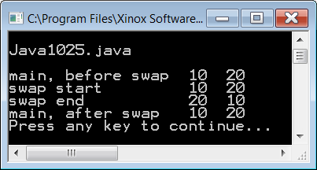
// Java1025.java
// This program attempts to swap the p and q variable values, which does not work as expected.
public class Java1025
{
public static void main (String args[])
{
System.out.println("\nJava1025.java\n");
int p = 10;
int q = 20;
System.out.println("main, before swap " + p + " " + q);
swap(p,q);
System.out.println("main, after swap " + p + " " + q);
}
public static void swap(int x, int y)
{
System.out.println("swap start " + x + " " + y);
int temp = x;
x = y;
y = temp;
System.out.println("swap end " + x + " " + y);
}
}

Slide 73
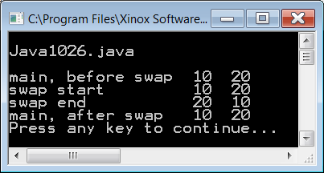
// Java1026.java
// This program demonstrates the swapping process without a method.
// The swapping of variables x and y simulates the parameter passing concept.
// Note that changes made to variables x and y do not impact variable p and q.
public class Java1026
{
public static void main (String args[])
{
System.out.println("\nJava1026.java\n");
int p = 10;
int q = 20;
System.out.println("main, before swap " + p + " " + q);
int x = p;
int y = q;
System.out.println("swap start " + x + " " + y);
int temp = x;
x = y;
y = temp;
System.out.println("swap end " + x + " " + y);
System.out.println("main, after swap " + p + " " + q);
}
}

Slide 74
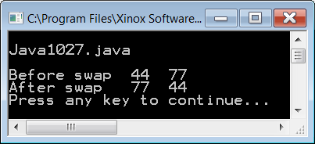
// Java1027.java
// This second example of using a <swap> method does swap the
// requested array elements.
public class Java1027
{
public static void main (String args[])
{
System.out.println("\nJava1027.java\n");
int[] list = {11,22,33,44,55,66,77,88,99};
System.out.println("Before swap " + list[3] + " " + list[6]);
swap(list,3,6);
System.out.println("After swap " + list[3] + " " + list[6]);
}
public static void swap(int[] x, int p, int q)
{
int temp = x[p];
x[p] = x[q];
x[q] = temp;
}
}

